Slide 1
Sign Language Recognition
Using Transfer Learning

Slide 2
Motivation
Voice-enabled assistants have revolutionized modern devices but remain inaccessible to over 70 million Deaf individuals worldwide and 1.5+ billion people with hearing loss.
Fingerspelling, a component of American Sign Language (ASL), offers a promising alternative for text entry on mobile devices.
Unfortunately, these technologies are often not accessible to the more than 70 million Deaf people around the world who use sign language to communicate, nor to the 1.5+ billion people affected by hearing loss globally
Fingerspelling uses hand shapes that represent individual letters to convey words. While fingerspelling is only a part of ASL, it is often used for communicating names, addresses, phone numbers, and other information commonly entered on a mobile phone.
Many Deaf smartphone users can fingerspell words faster than they can type on mobile keyboards.

Slide 3
Objective
The goal of this project is to detect and translate American Sign Language (ASL) fingerspelling into text.
It is based on a large dataset of over three million fingerspelled characters produced by over 100 Deaf signers captured via the selfie camera of a smartphone with a variety of backgrounds and lighting conditions.
It helps in making it more accessible for the Deaf and Hard of Hearing community.
Fingerspelling is an important part of ASL and is often used for communicating names, addresses, phone numbers, and other information commonly entered on a mobile phone.
ASL fingerspelling can be substantially faster than typing on a smartphone’s virtual keyboard.
Sign language recognition AI for text entry lags far behind voice-to-text or even gesture-based typing, as robust datasets didn't previously exist.
It helps in provide Deaf and Hard of Hearing users with the option to fingerspell words instead of using a keyboard, enabling them to communicate with hearing non-signers more quickly and smoothly.

Slide 4
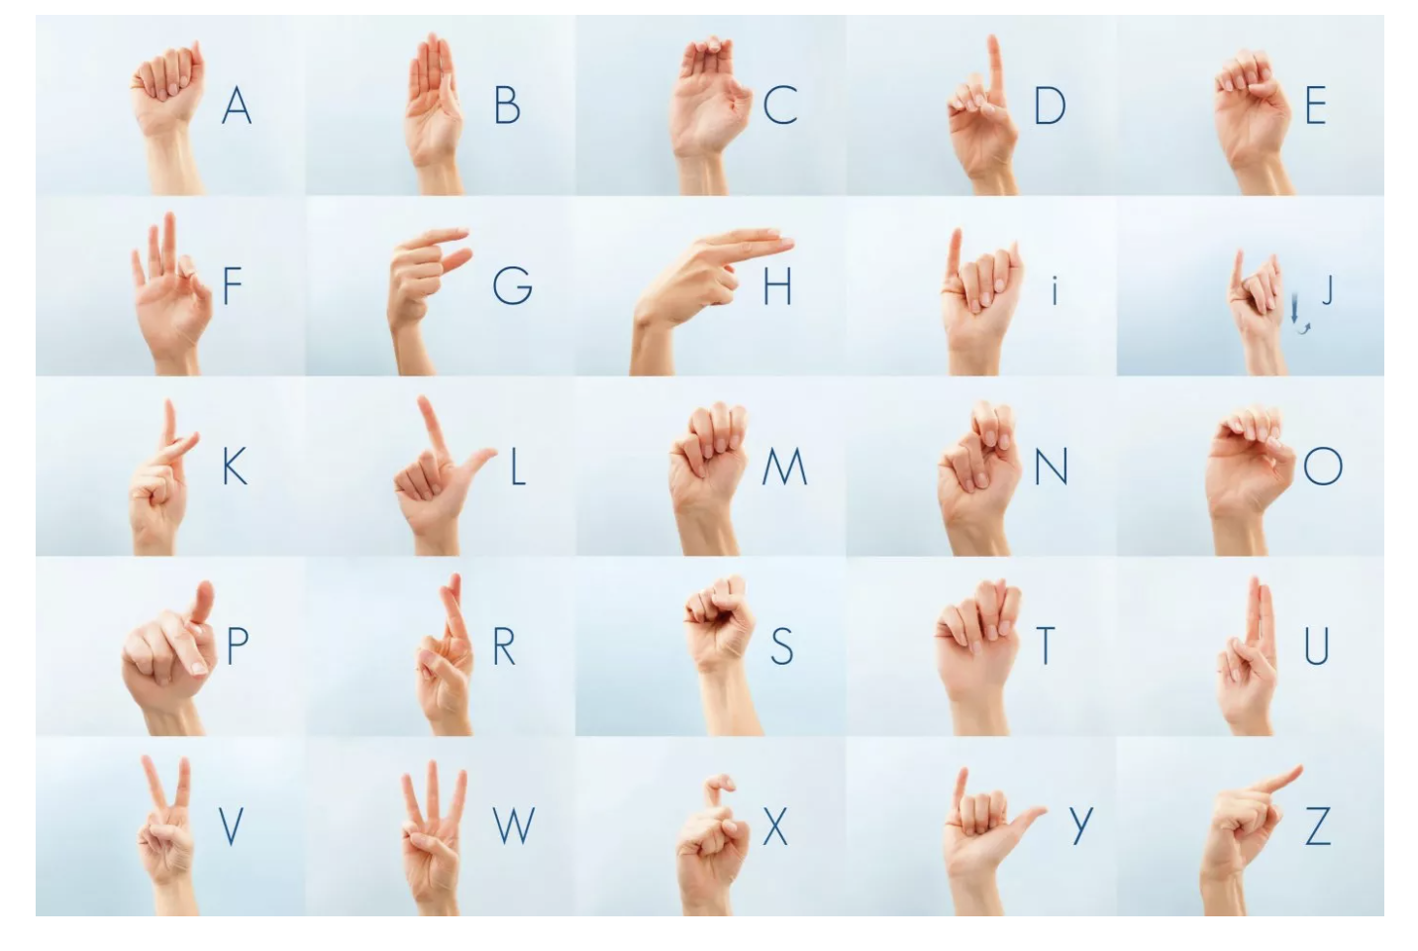
Signs

Slide 5
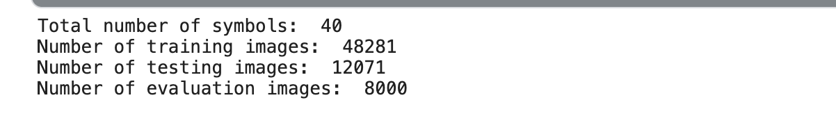
Data overview

Slide 6
Pretrained Model
A pre-trained model has been previously trained on a dataset and contains the weights and biases that represent the features of whichever dataset it was trained on.
Learned features are often transferable to different data.
For example, a model trained on a large dataset of bird images will contain learned features like edges or horizontal lines that you would be transferable your dataset.

Slide 7
Why use a Pre-trained Model?
Pre-trained models are beneficial to us for many reasons. By using a pre-trained model, you are saving time.
Someone else has already spent the time and compute resources to learn a lot of features and your model will likely benefit from

Slide 8
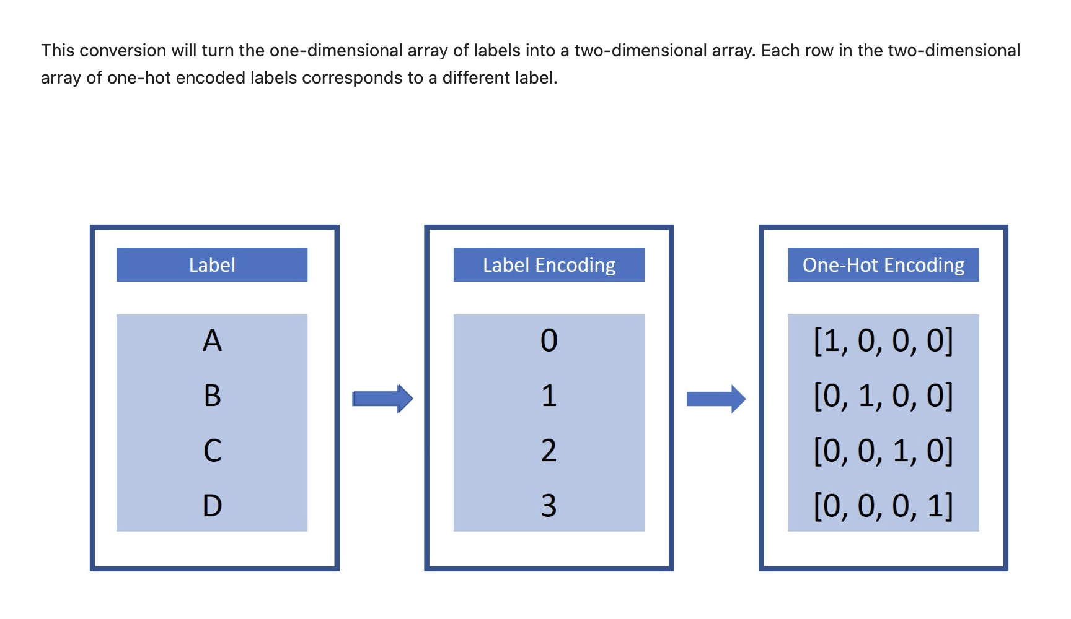
Preprocessing

Slide 9
Normalization
Normalization will help us remove distortions caused by lights and shadows in an image
Normalization improves model convergence, reduces sensitivity to scale and shift, and balances input features for more effective learning.
Pixel scaling, mean subtraction, and standardization are widely used normalization techniques in image processing tasks
Normalization will help us remove distortions caused by lights and shadows in an image
It is essential in tasks like image classification, object detection, and segmentation to ensure consistent and optimal input data for machine learning models
It is essential in tasks like image classification, object detection, and segmentation to ensure consistent and optimal input data for machine learning models

Slide 10
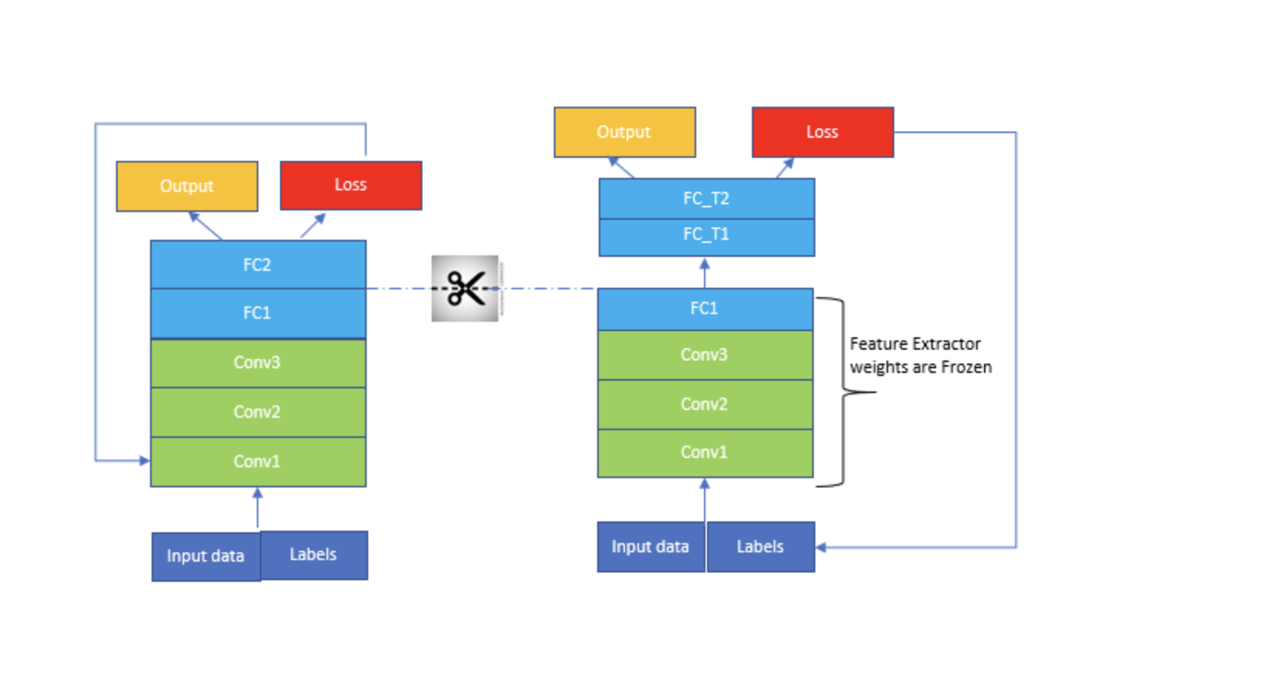
Model Architecture

Slide 11
Models Used
VGG16
Resnet 50

Slide 12
VGG16
VGG16 is a convolution neural net (CNN ) architecture which was used to win ILSVR(Image net) competition in 2014. It is one of the excellent vision model architecture till date.
Most unique thing about VGG16 is that instead of having a large number of hyper-parameter they focused on having convolution layers of 3x3 filter with a stride 1 and always used same padding and maxpool layer of 2x2 filter of stride 2.
It follows this arrangement of convolution and max pool layers consistently throughout the whole architecture. In the end it has 2 FC(fully connected layers) followed by a soft max for output.
The 16 in VGG16 refers to it has 16 layers that have weights. This network is a pretty large network and it has about 138 million (approx) parameters.

Slide 13
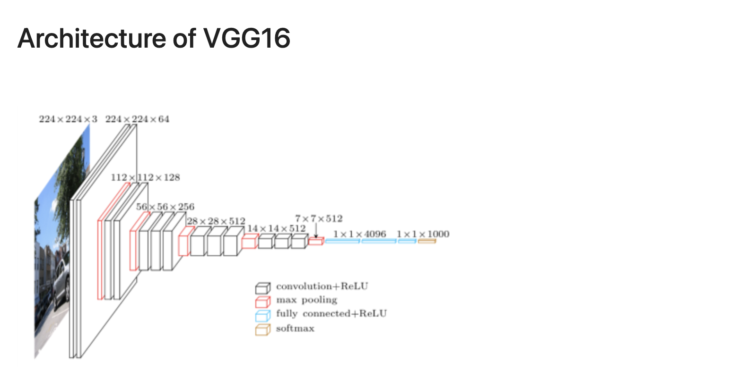

Slide 14
Resnet 50
ResNet-50 is a convolutional neural network (CNN) architecture that revolutionized deep learning in image recognition tasks. It was proposed by Kaiming He et al. in their paper titled "Deep Residual Learning for Image Recognition," published in 2015
The most distinctive feature of ResNet-50 is its use of residual learning blocks, which introduce skip connections or shortcuts to alleviate the vanishing gradient problem. Instead of directly learning the desired underlying mapping, ResNet-50 learns residual functions, which are the differences between the input and output of certain layers.
ResNet-50 architecture follows a pattern where each residual block contains several convolutional layers with batch normalization and ReLU activation functions, along with shortcut connections. The network architecture ends with global average pooling and a fully connected layer followed by a softmax activation function for classification.
The 50 in ResNet-50 denotes the number of weight layers in the network. Despite its depth, ResNet-50 maintains computational efficiency and scalability, making it suitable for various applications, including real-time systems and resource-constrained environments.

Slide 15
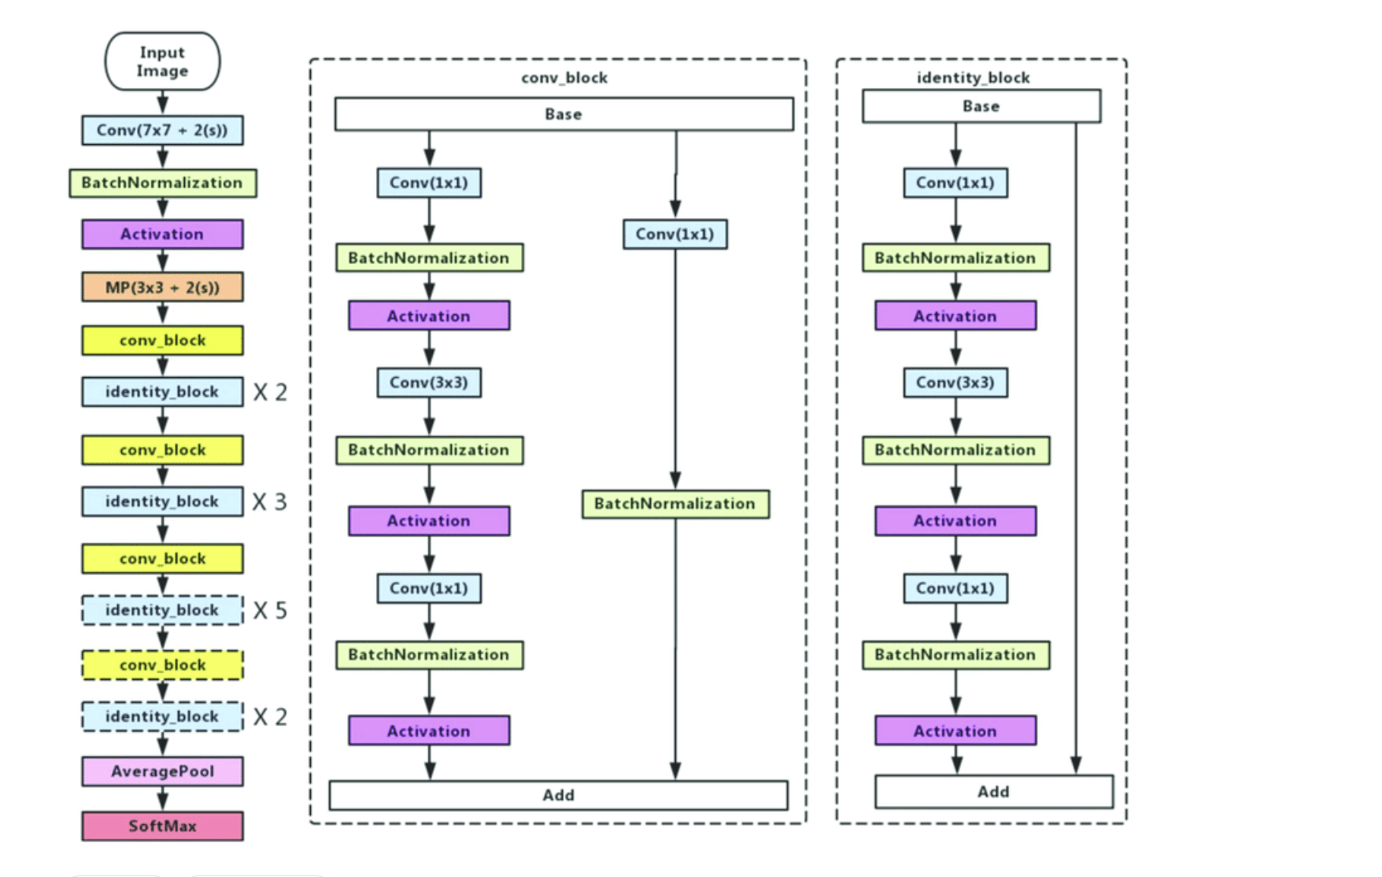
Architecture of Resnet50

Slide 16
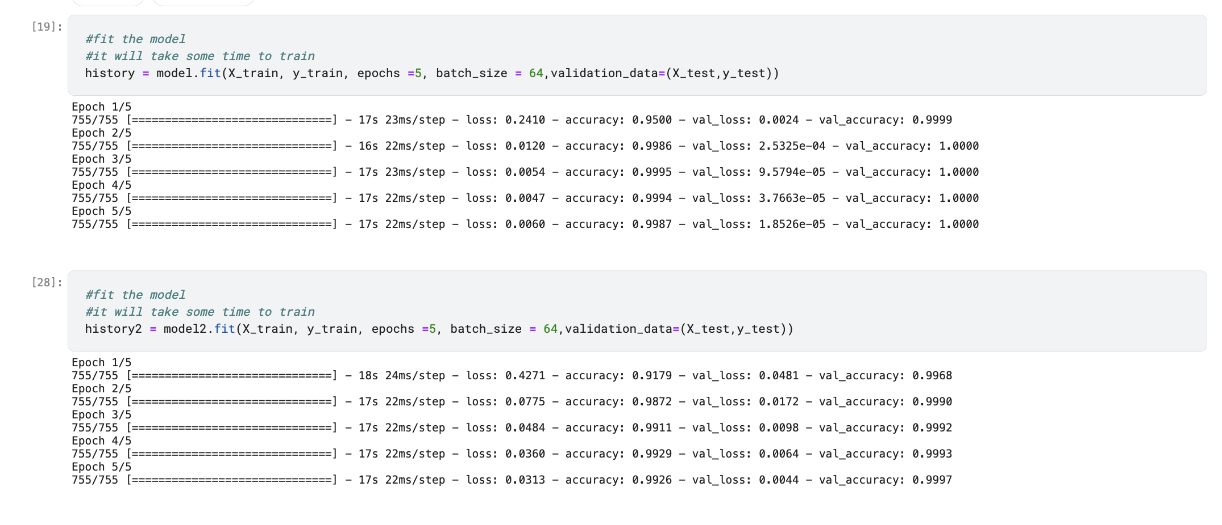
Training the models

Slide 17
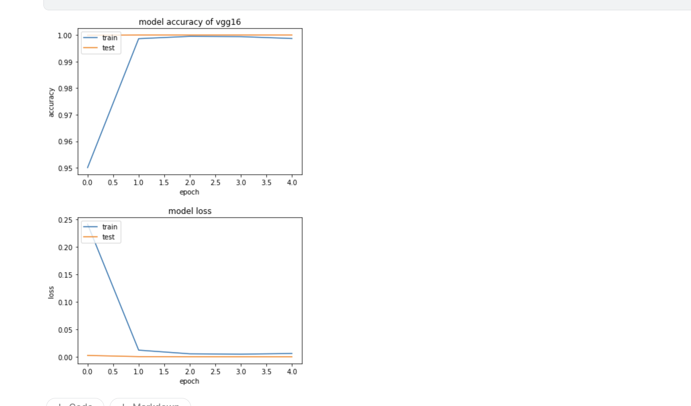
VGG 16 Model Loss and Accuracy Plot

Slide 18
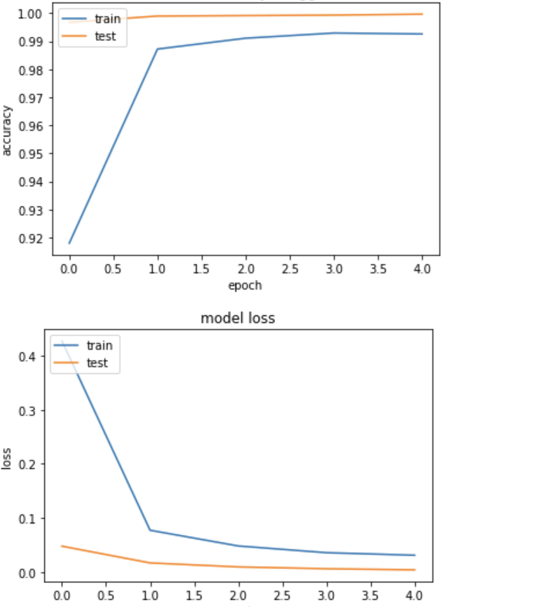
Resnet 50 Loss and Accuracy Plot

Slide 19
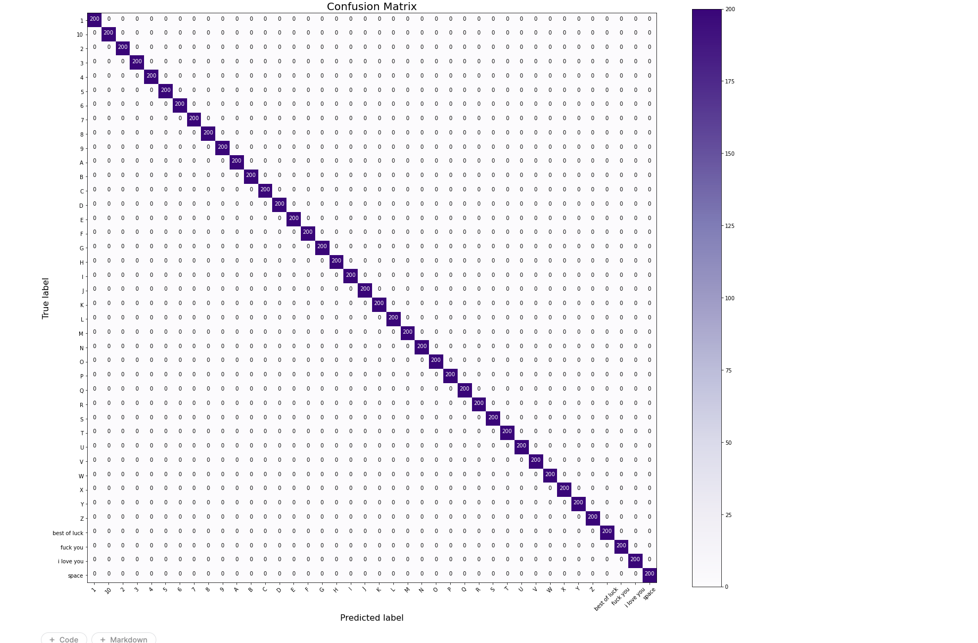
Confusion Matrix

Slide 20
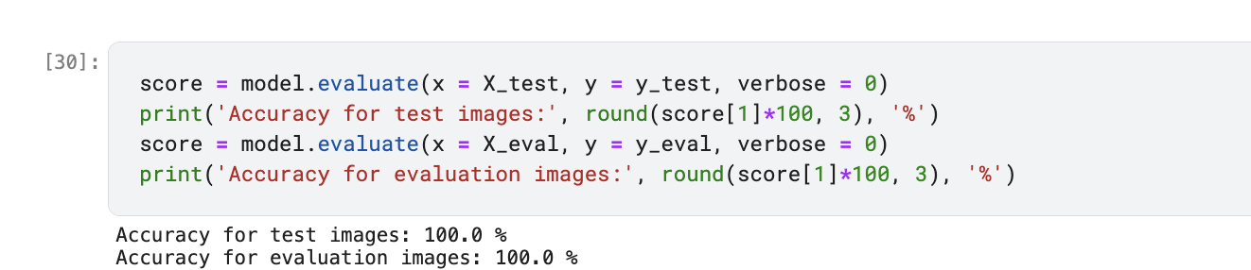
Test Accuracy VGG 16

Slide 21
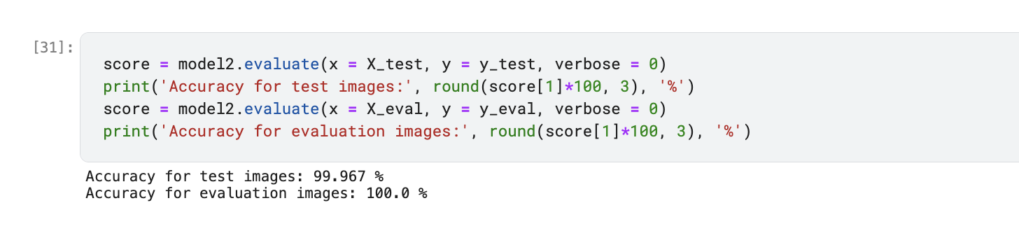
Test Accuracy Resnet 50

Slide 22
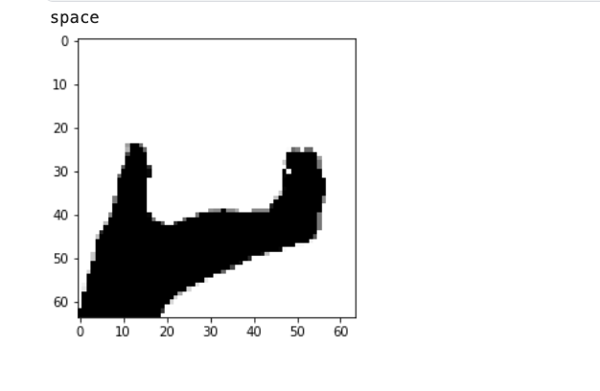
VGG 16 Predictions

Slide 23
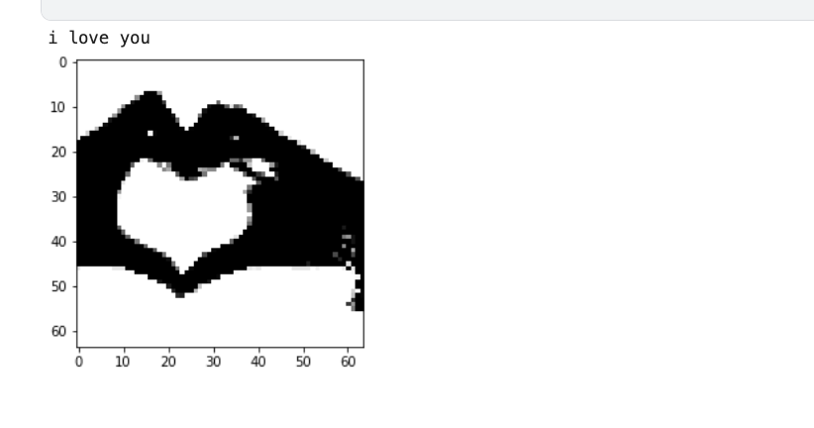
Resnet50 Predictions

Slide 24
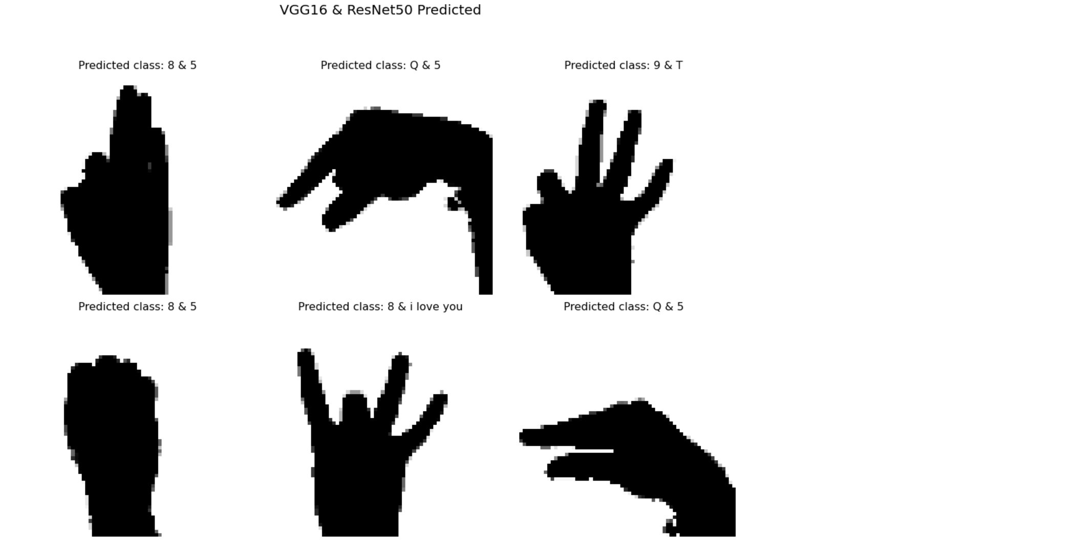
Some predictions

Slide 25
Future Scope
Vision: Develop a cutting-edge real-time web application for sign language recognition.
Key Features:
Enable camera access to capture live sign language gestures.
Utilize machine learning models to process and interpret sign language in real-time.
Display translated text output directly on the web application interface.
Benefits:
Enhance accessibility and communication for individuals with hearing impairments.
Provide instant feedback and support for sign language users.
Facilitate language learning and interaction in diverse settings.
Impact:
Transforming the way people communicate and interact online.
Empowering individuals with disabilities to participate more fully in digital spaces.
Future Steps:
Implement and refine the real-time sign language recognition system.
Conduct user testing and gather feedback for iterative improvements.
Explore potential partnerships and collaborations for broader deployment and impact.

